Slide 1
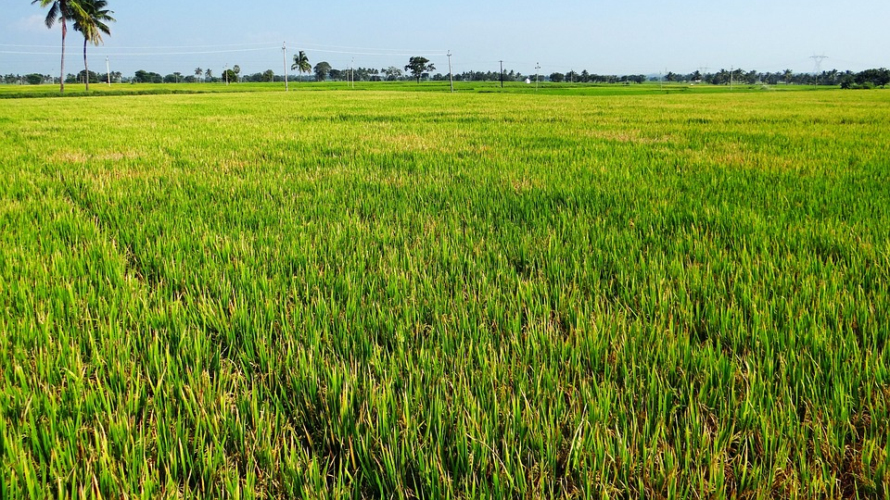
Indian Agriculture analysis
Using Power BI
Mentorness internship task 3
-By Sai Vyshnavi Gudipalli

Slide 2
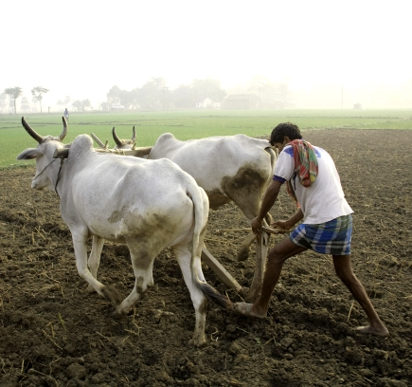
OVERVIEW
This internship project aims to conduct a comprehensive analysis of Indian agriculture, focusing on district-wise and year-wise data.
The dataset provides detailed information on various crops, their areas, production, and yields across different districts and years.
My goal is to leverage Power BI to create interactive visualizations that uncover trends, patterns, and disparities in agricultural practices, enabling stakeholders to make informed decisions for sustainable farming and resource allocation.
This Photo by Unknown author is licensed under CC BY-SA-NC.

Slide 3

IMPORTANCE
It is really important to analyze Indian farming and the data because it helps people understand how crops are behaving in different places at different times.
And also, by properly analyzing the data, we can actually think of ways to make farming better, like what crops should be grown at that particular time.
That means we can utilize the land and other resources properly and grow more food.
We can also learn how weather and other outside things affect crops, so farmers can be ready for anything. This kind of information helps us plan for the future and make sure everyone has enough food to eat.

Slide 4
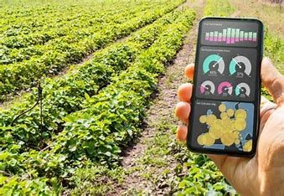
DATA SET
The dataset we have has information about farming in India. It tells us different things, like how much area a particular crop needs, the production and yield of the crops in their respective states, and districts.
By looking at and understanding the data, we can tell which crops are doing well, at which places they are doing well, and during which years.

Slide 5
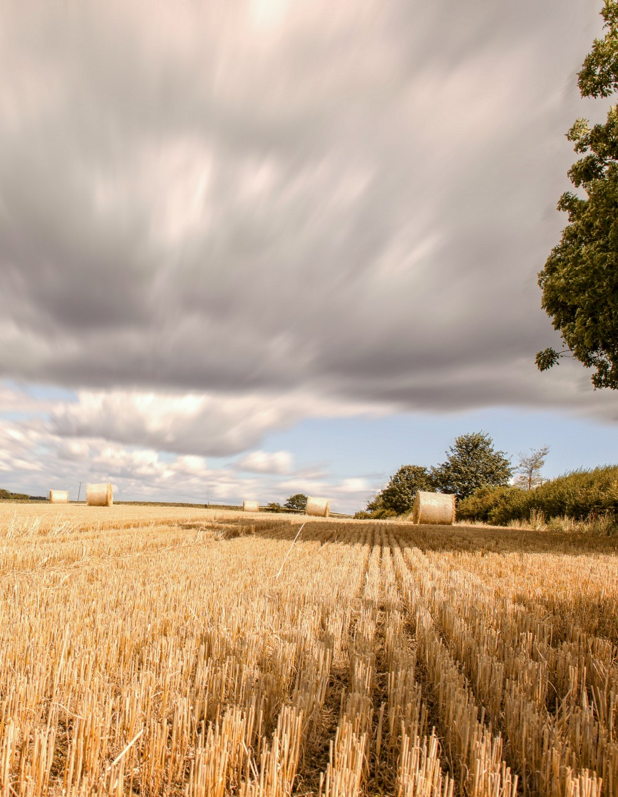
Project Objectives:
1. Data Exploration: Explored the dataset to understand the distribution of agricultural variables across districts and years.
2. Crop-specific Analysis: Analyzed the trends in the cultivation of major crops, including rice, wheat, and pulses, focusing on changes in area, production, and yield.
3. Regional Disparities: Identified disparities and variations in agricultural practices and outcomes across different districts and states.
4. Seasonal Patterns: Explored seasonal patterns in crop cultivation, considering kharif and rabi seasons.
5. Impact of External Factors: Investigated the impact of external factors like weather conditions on crop performance.
6. Fruits and Vegetables Analysis: Analyzed the cultivation trends of fruits, vegetables, and their overall contribution to agricultural practices.
7. Sustainable Farming Insights: Derived insights that can contribute to promoting sustainable farming practices and optimizing resource allocation.

Slide 6

Steps followed:
Create a new project in Power BI.
Click on get data in the home and import the csv file.
Check the data column towards the right to make sure that the file is imported.
Put it in the report view and make the dashboard and visualizations.
Import the correct visualization from the visualizations tab in the right.
By opting the format your visual, we can design our dashboard to make it more readable and attractive.
Add slicer for making the power BI interactive.
We can style the slicer to make it a tile, dropdown etc.
Use the dataset and make the visualizations.
Use the map visualization to show the area and the crop.

Slide 7
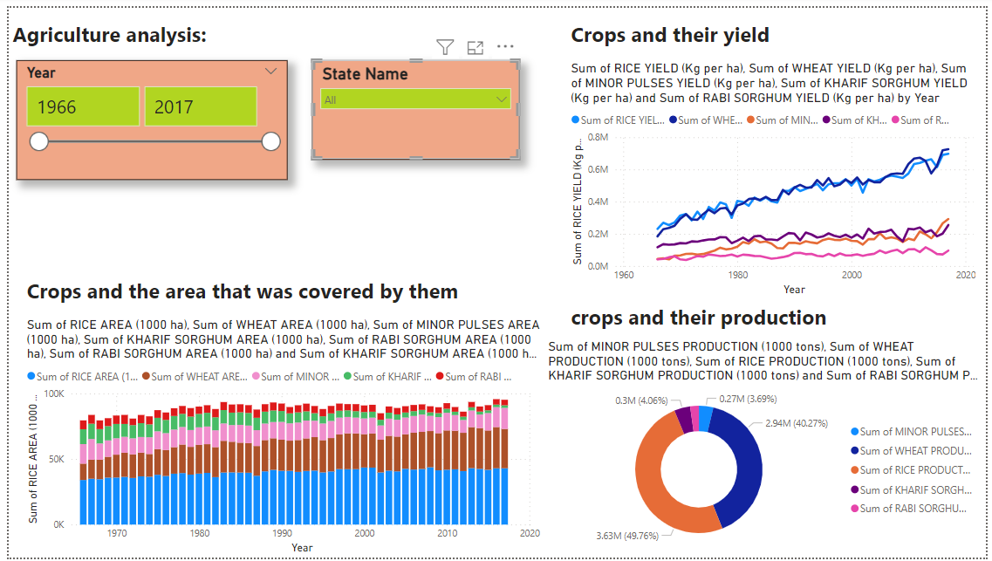

Slide 8
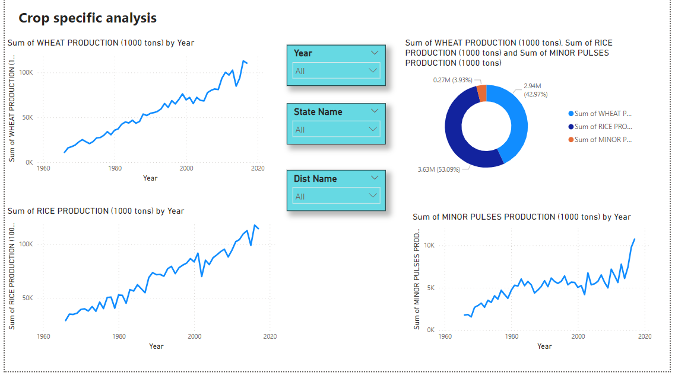

Slide 9
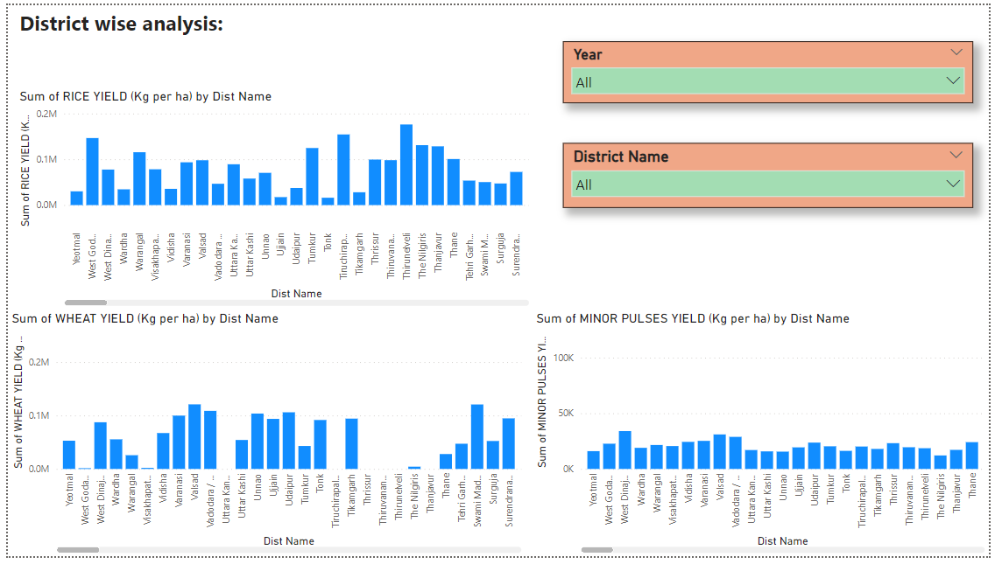

Slide 10
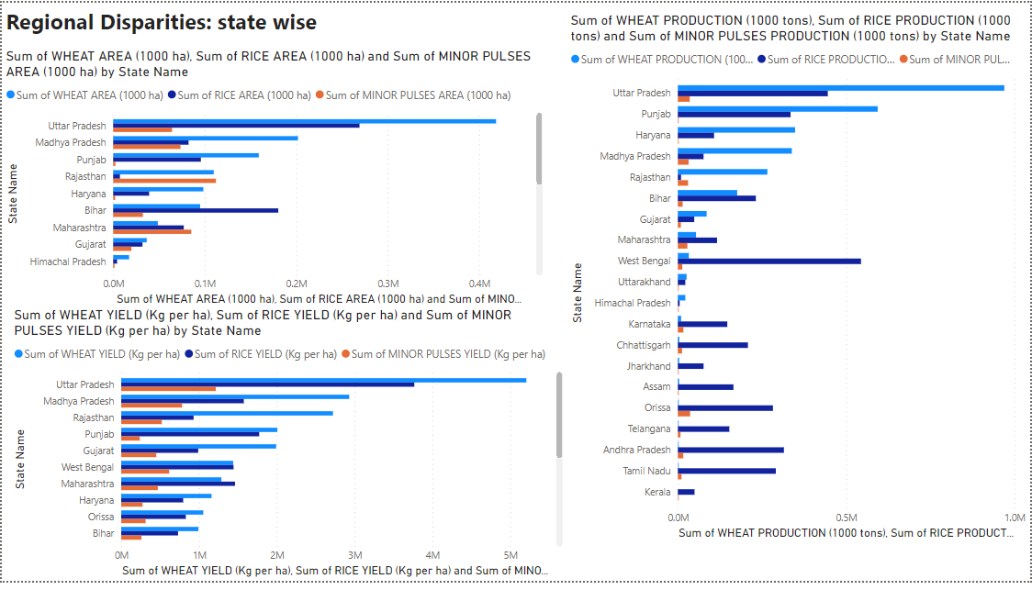

Slide 11
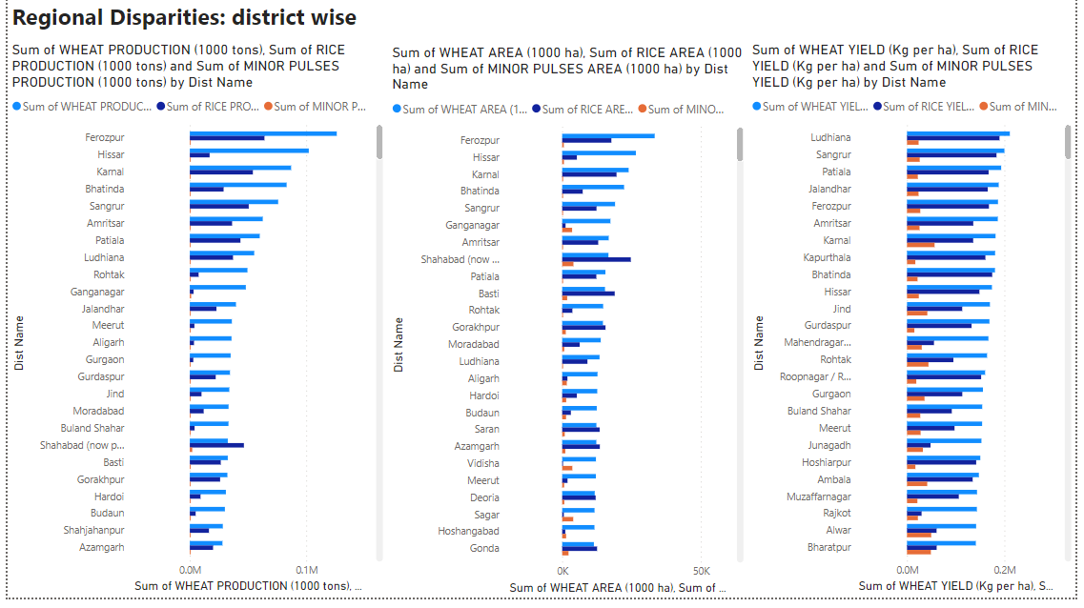

Slide 12
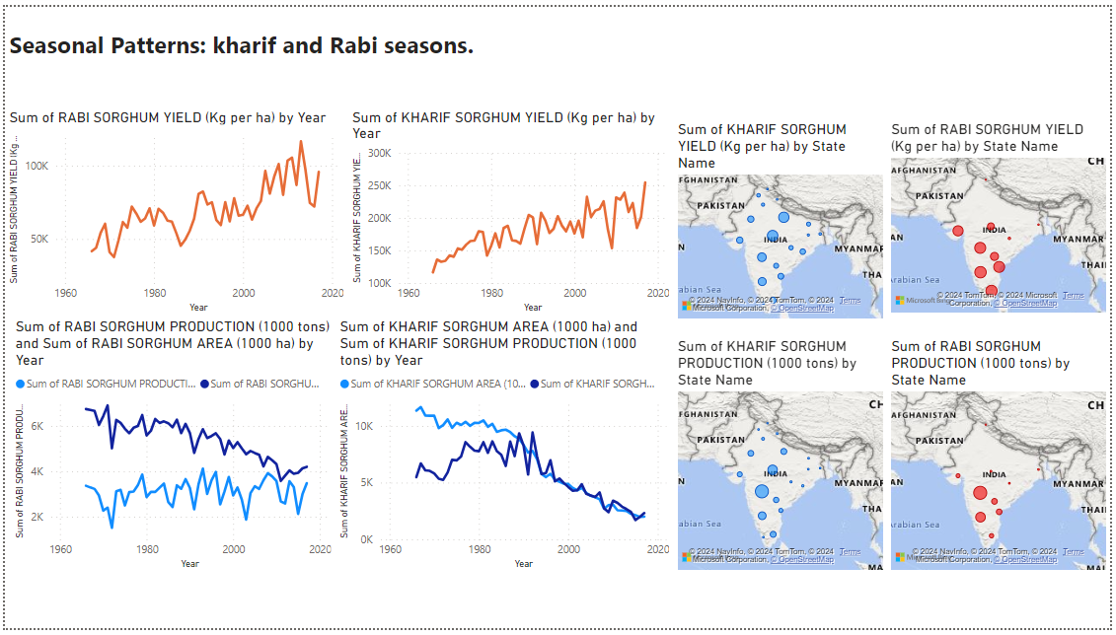

Slide 13
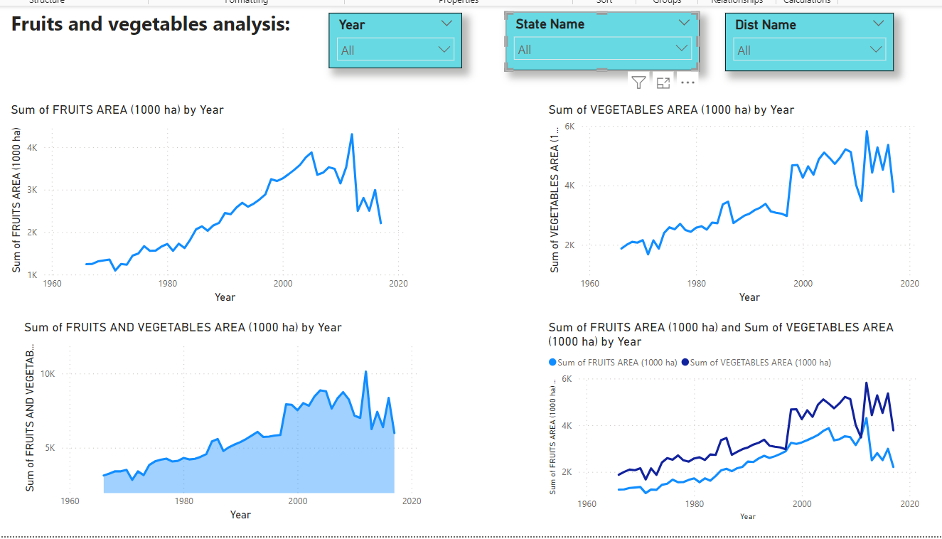

Slide 14
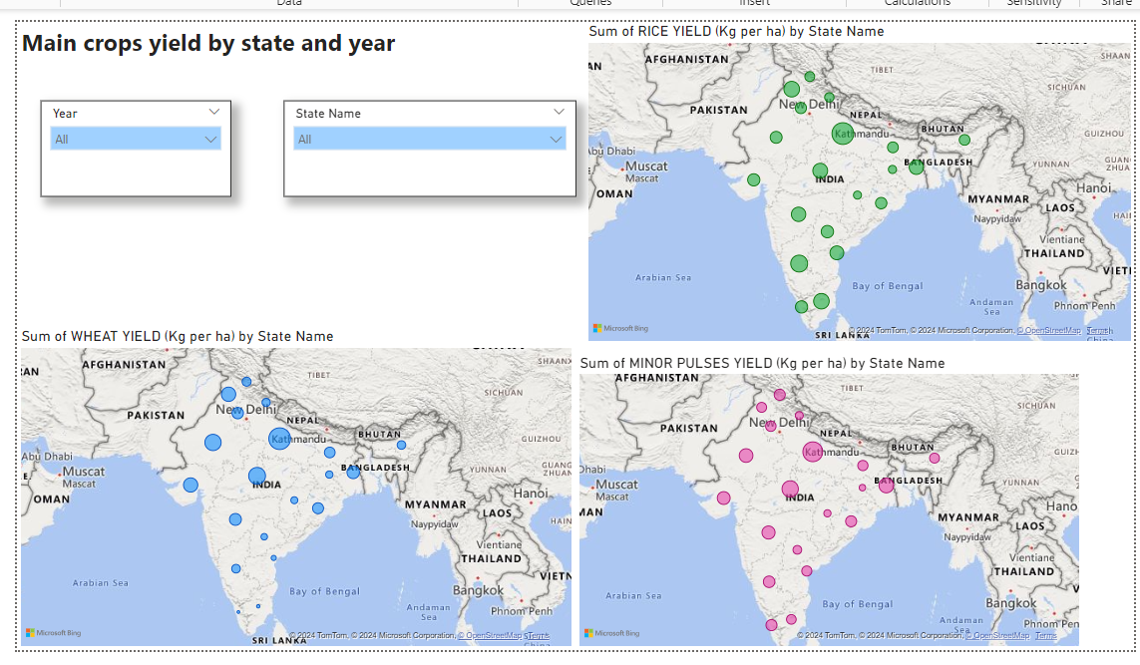

Slide 15
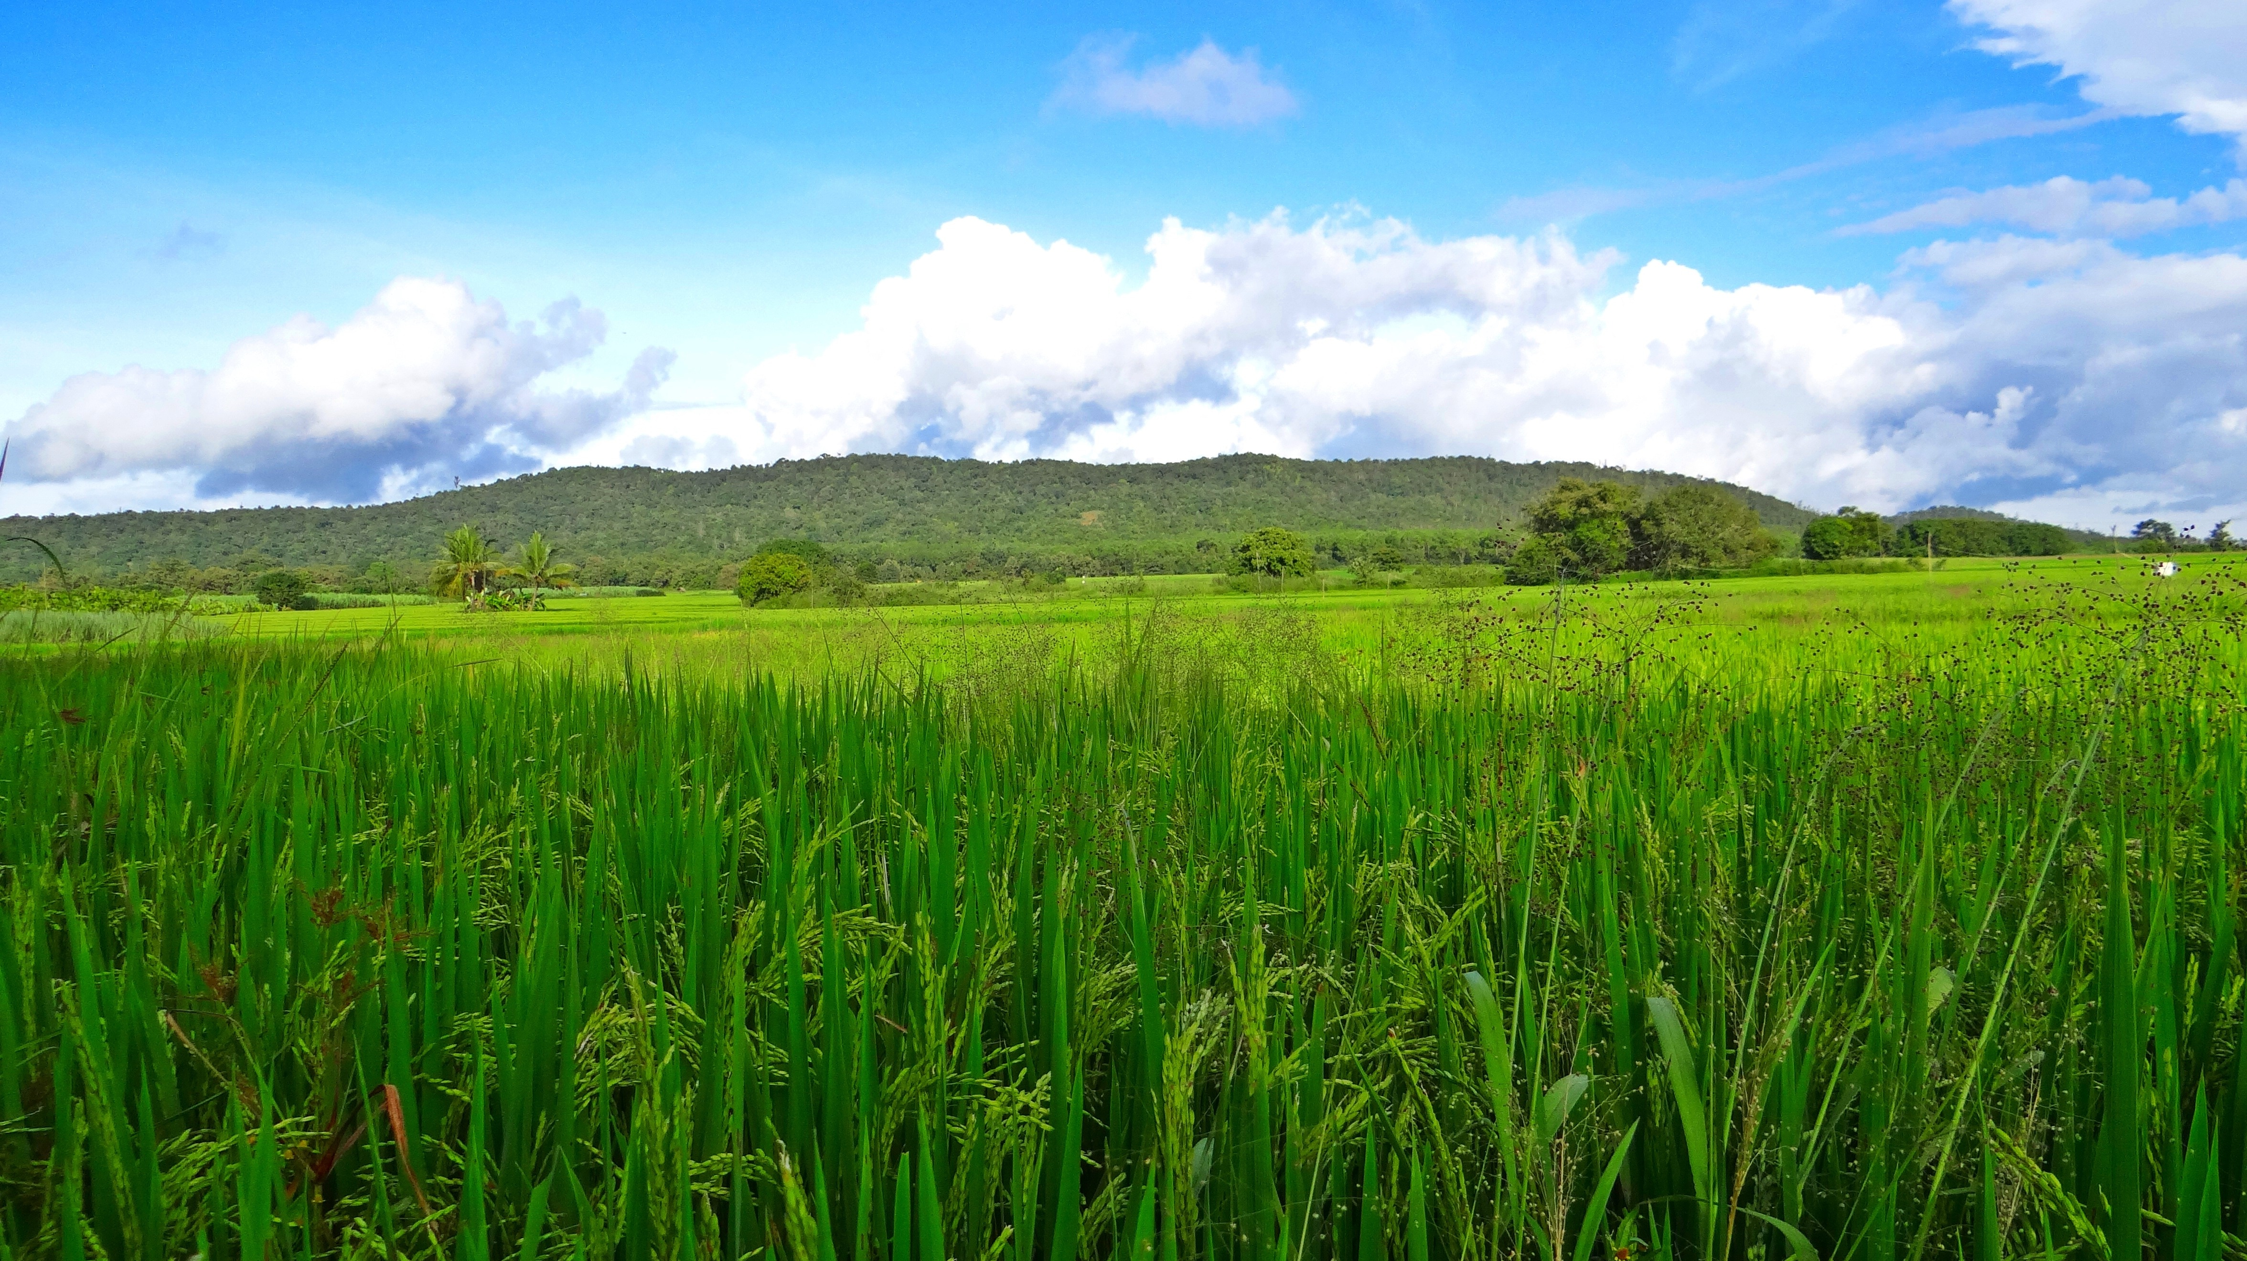
Thank you

